Slide 1
Uniqlo Shop
Author: Nguyễn Văn Minh Hiếu

Slide 2

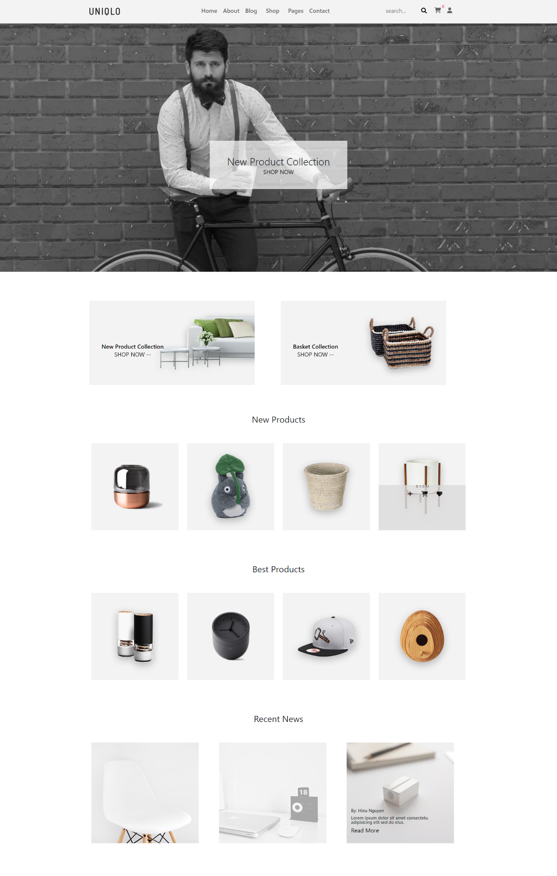
HOME

Slide 3
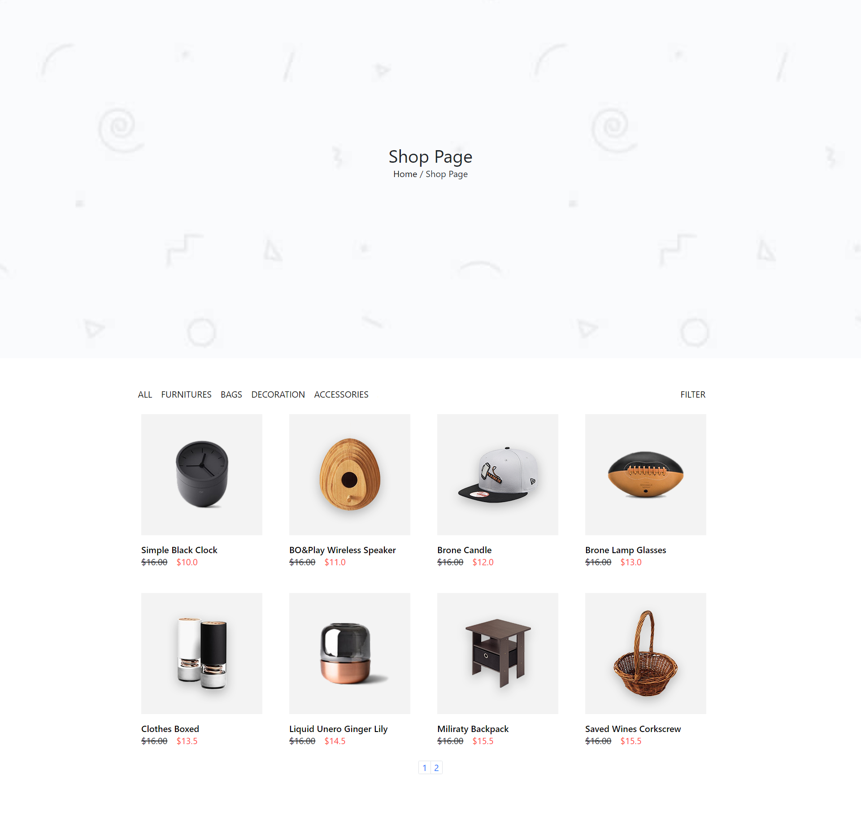
Category

Slide 4
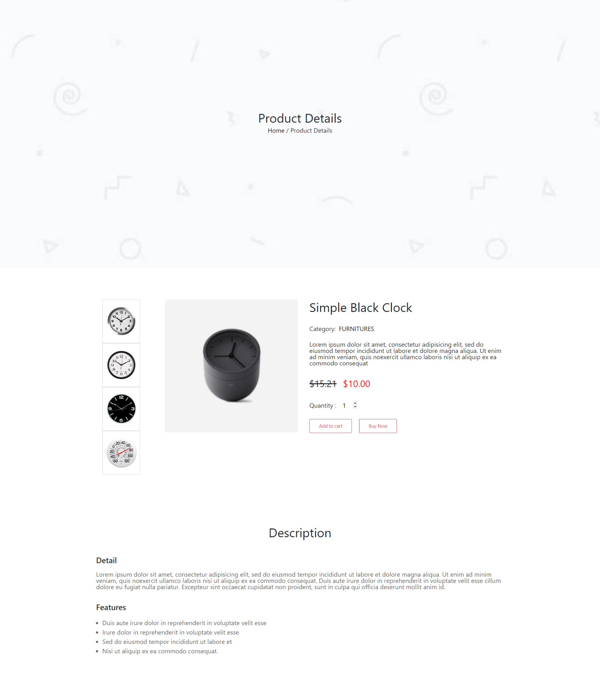
Product Detail

Slide 5
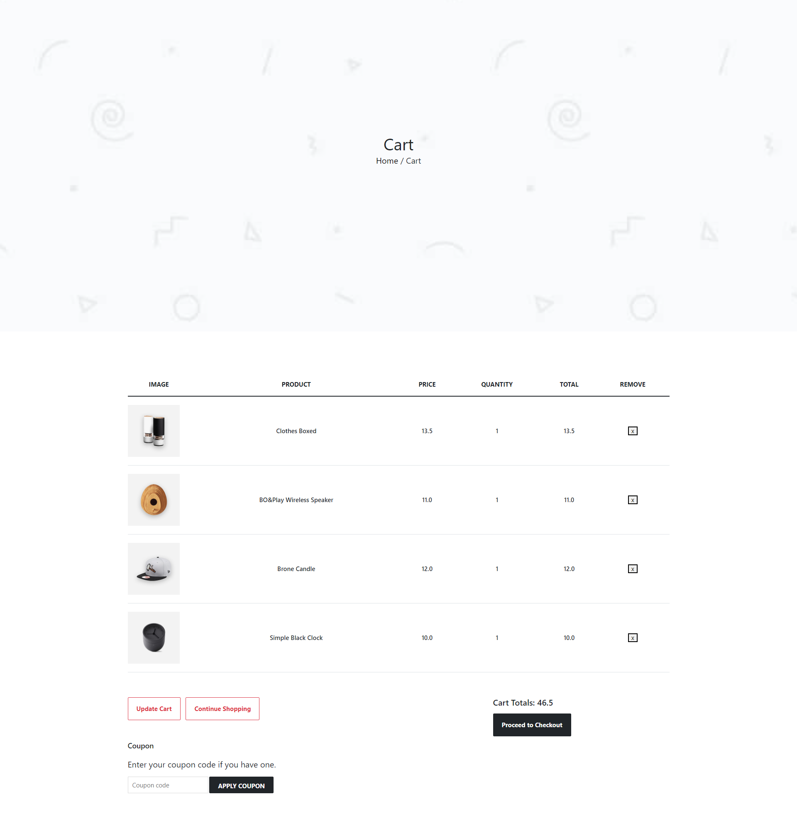
CART

Slide 6
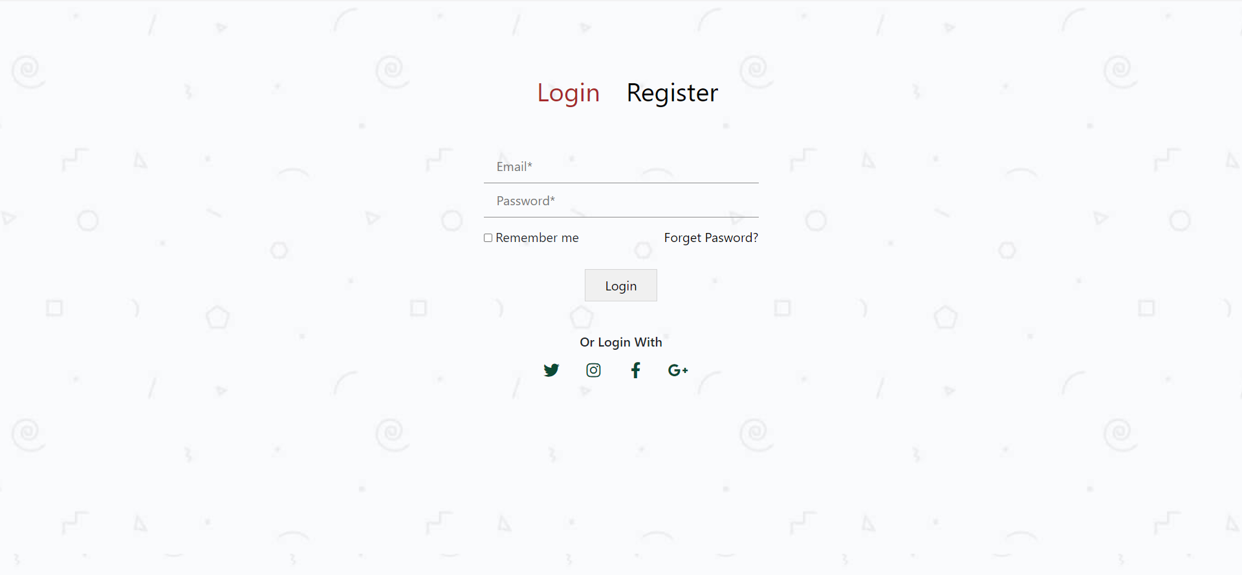
Login

Slide 7
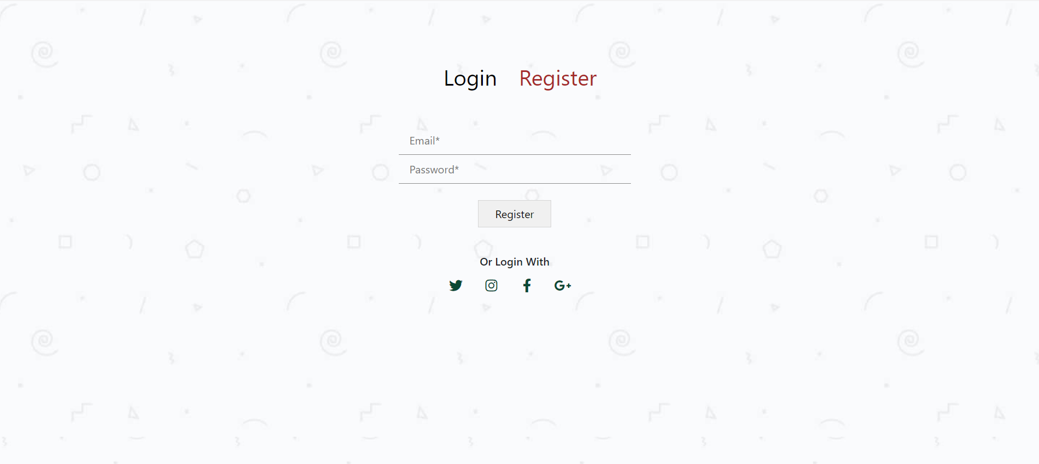
REGISTER

Slide 8
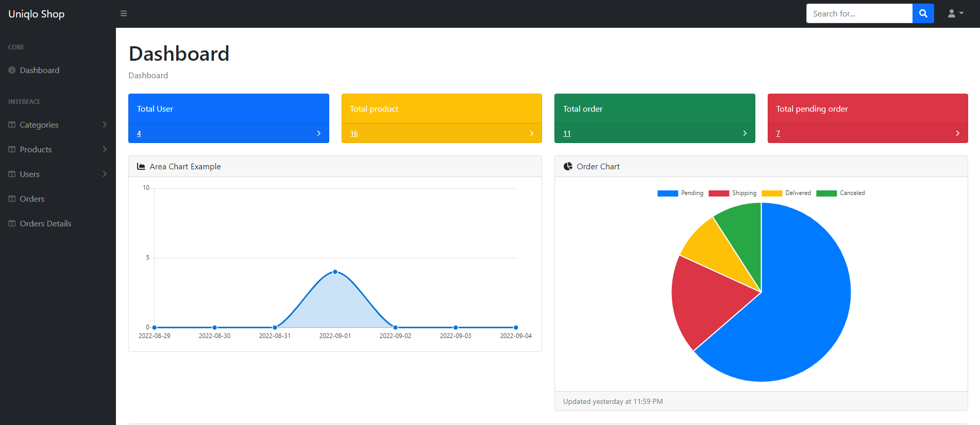
ADMIN - Dashboard

Slide 9
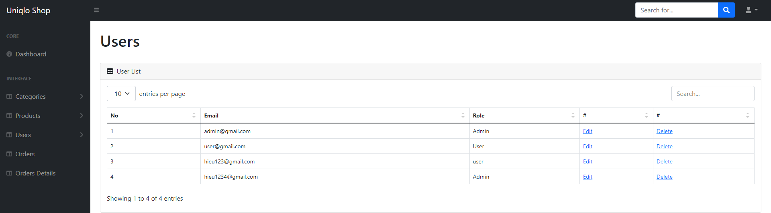
ADMIN - User

Slide 10
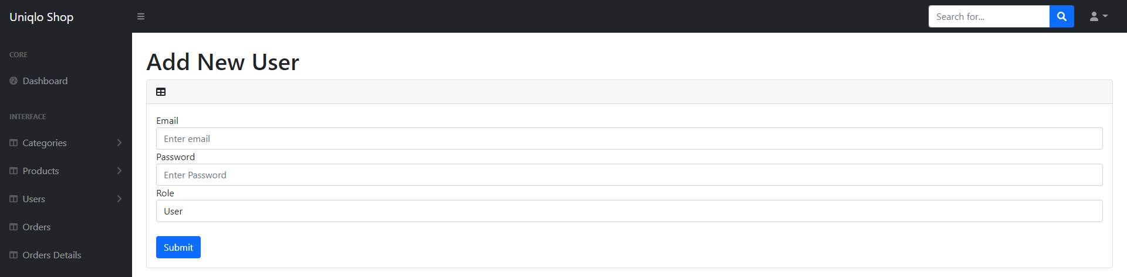
ADMIN - User

Slide 11
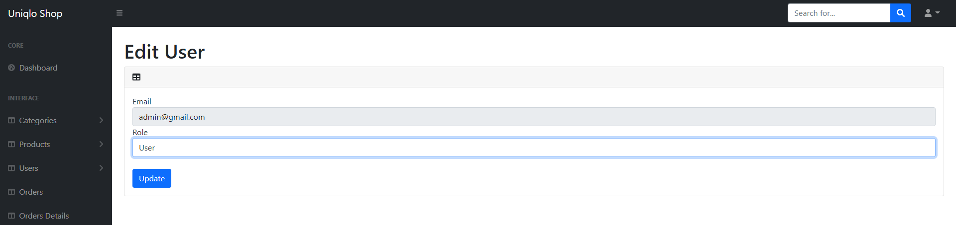
ADMIN - User

Slide 12
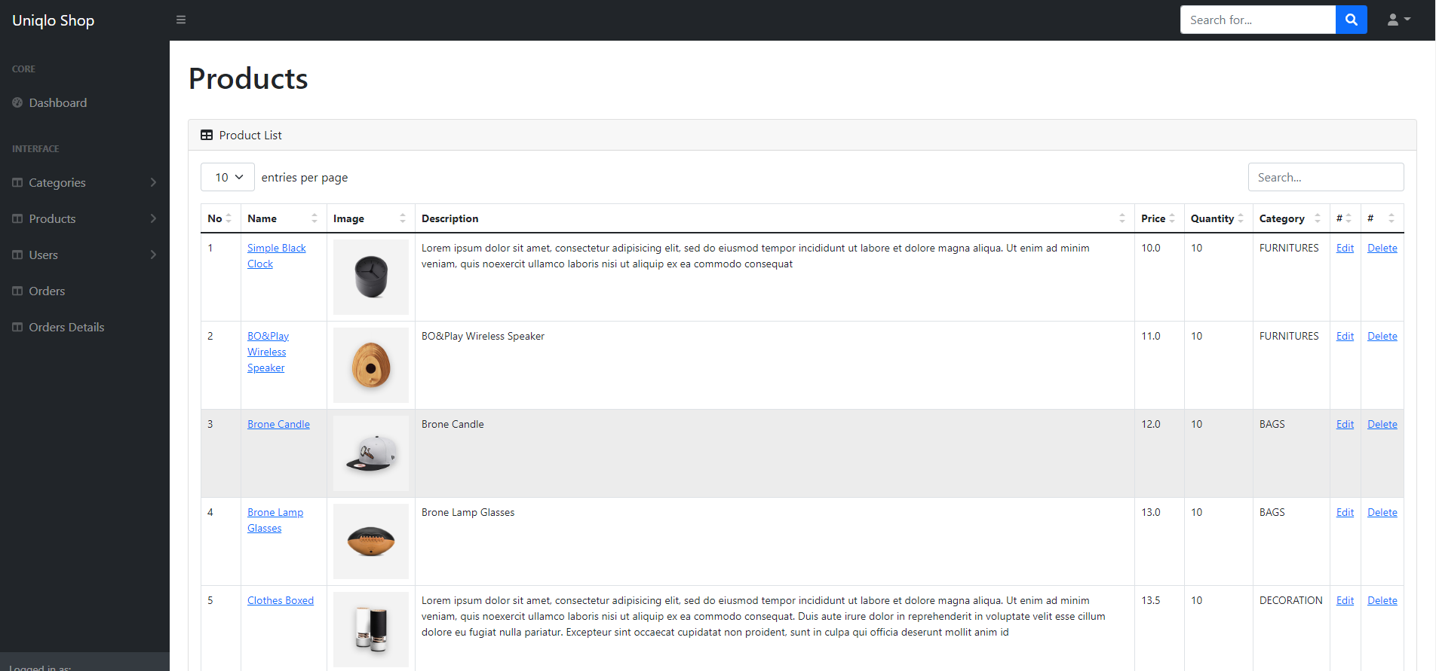
ADMIN - Product

Slide 13
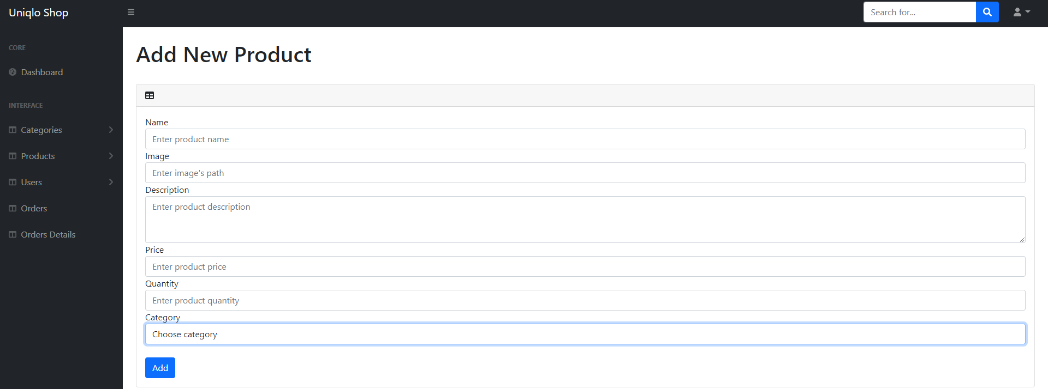
ADMIN - Product

Slide 14
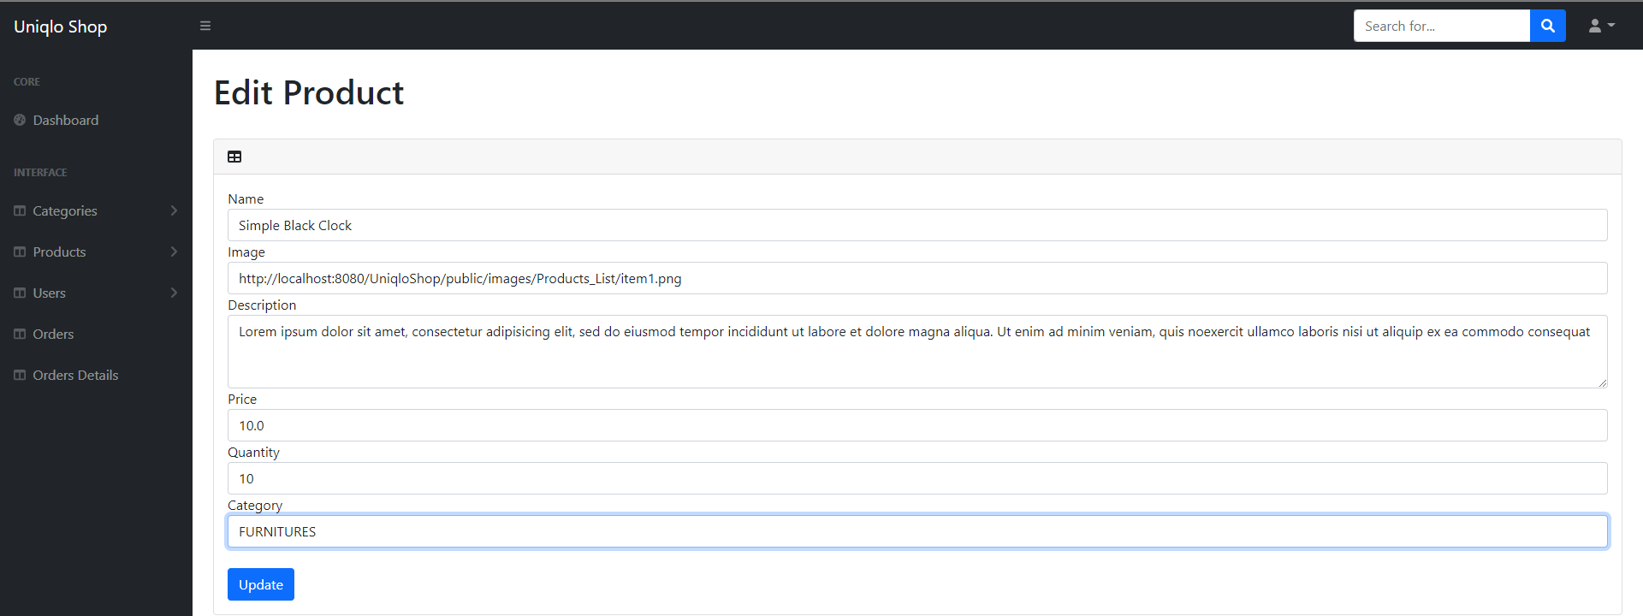
ADMIN - Product

Slide 15
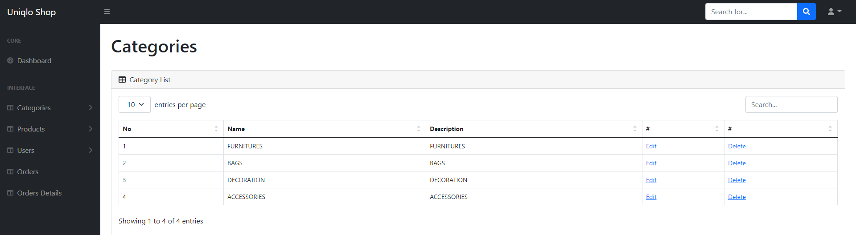
ADMIN - Category

Slide 16

ADMIN - Category

Slide 17

ADMIN - Category

Slide 18
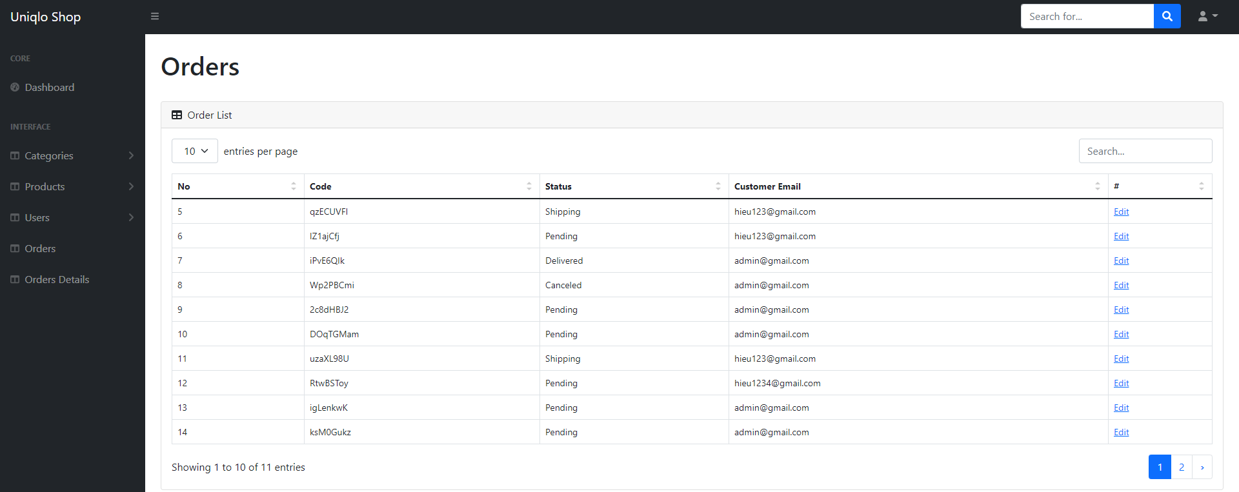
ADMIN - Order

Slide 19
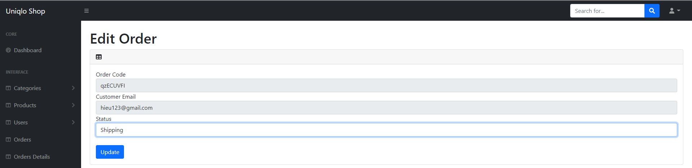
ADMIN - Order

Slide 20
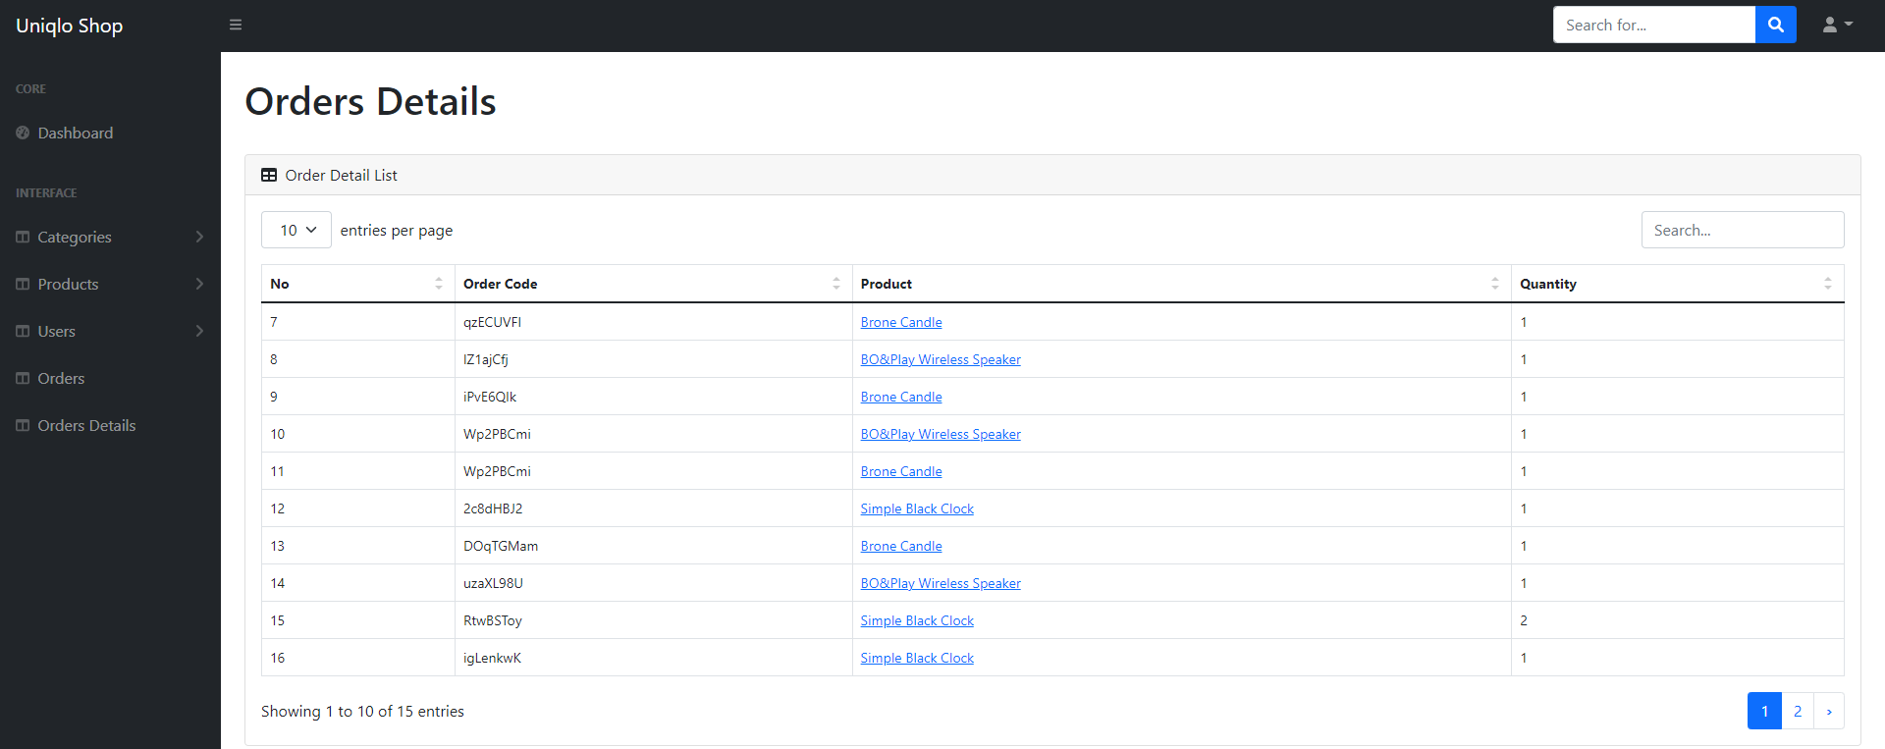
ADMIN – Order Detail

